Slide 1

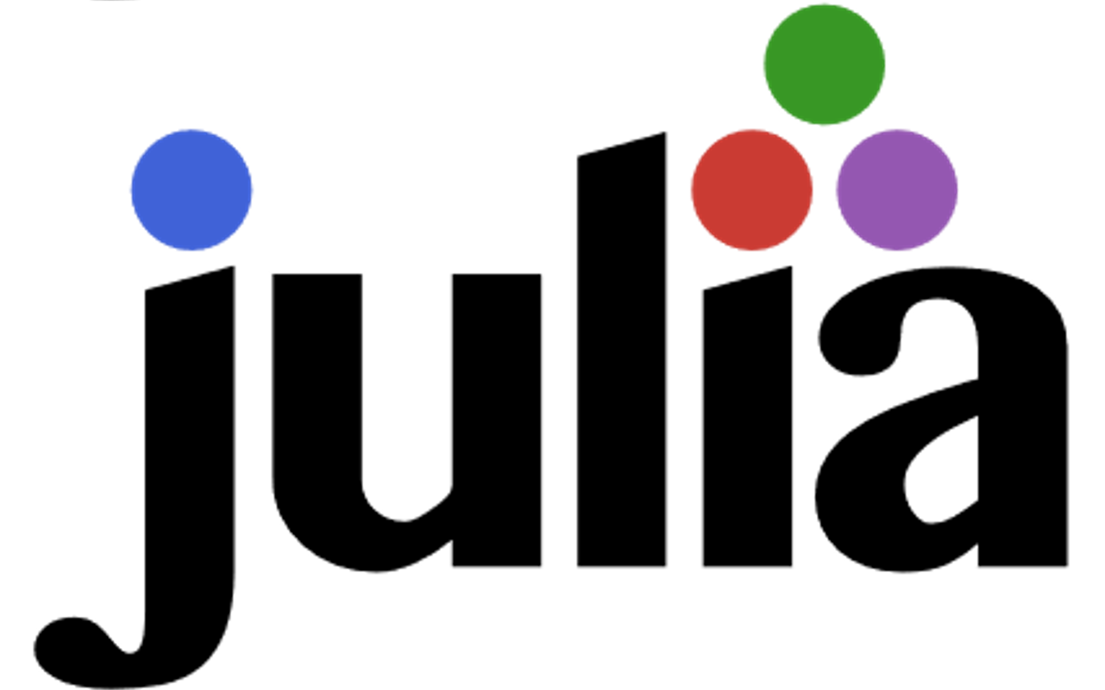


A programming language specifically made for scientists
Carsten Bauer @ University of Cologne, October 2019

Slide 2
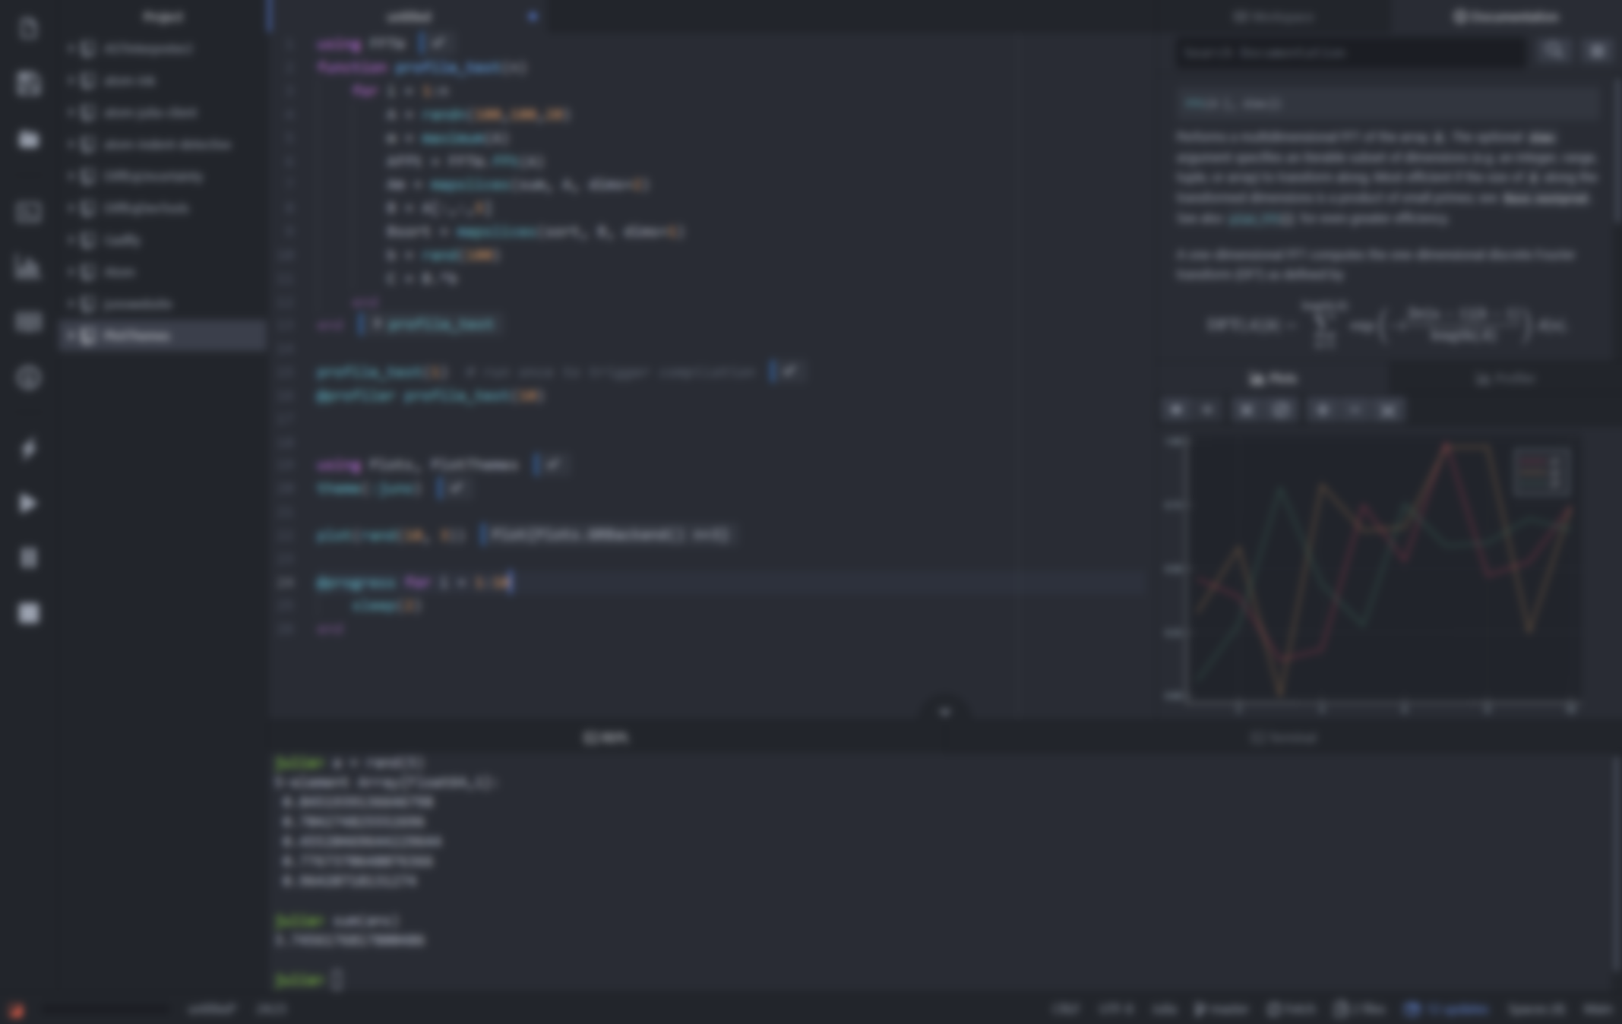
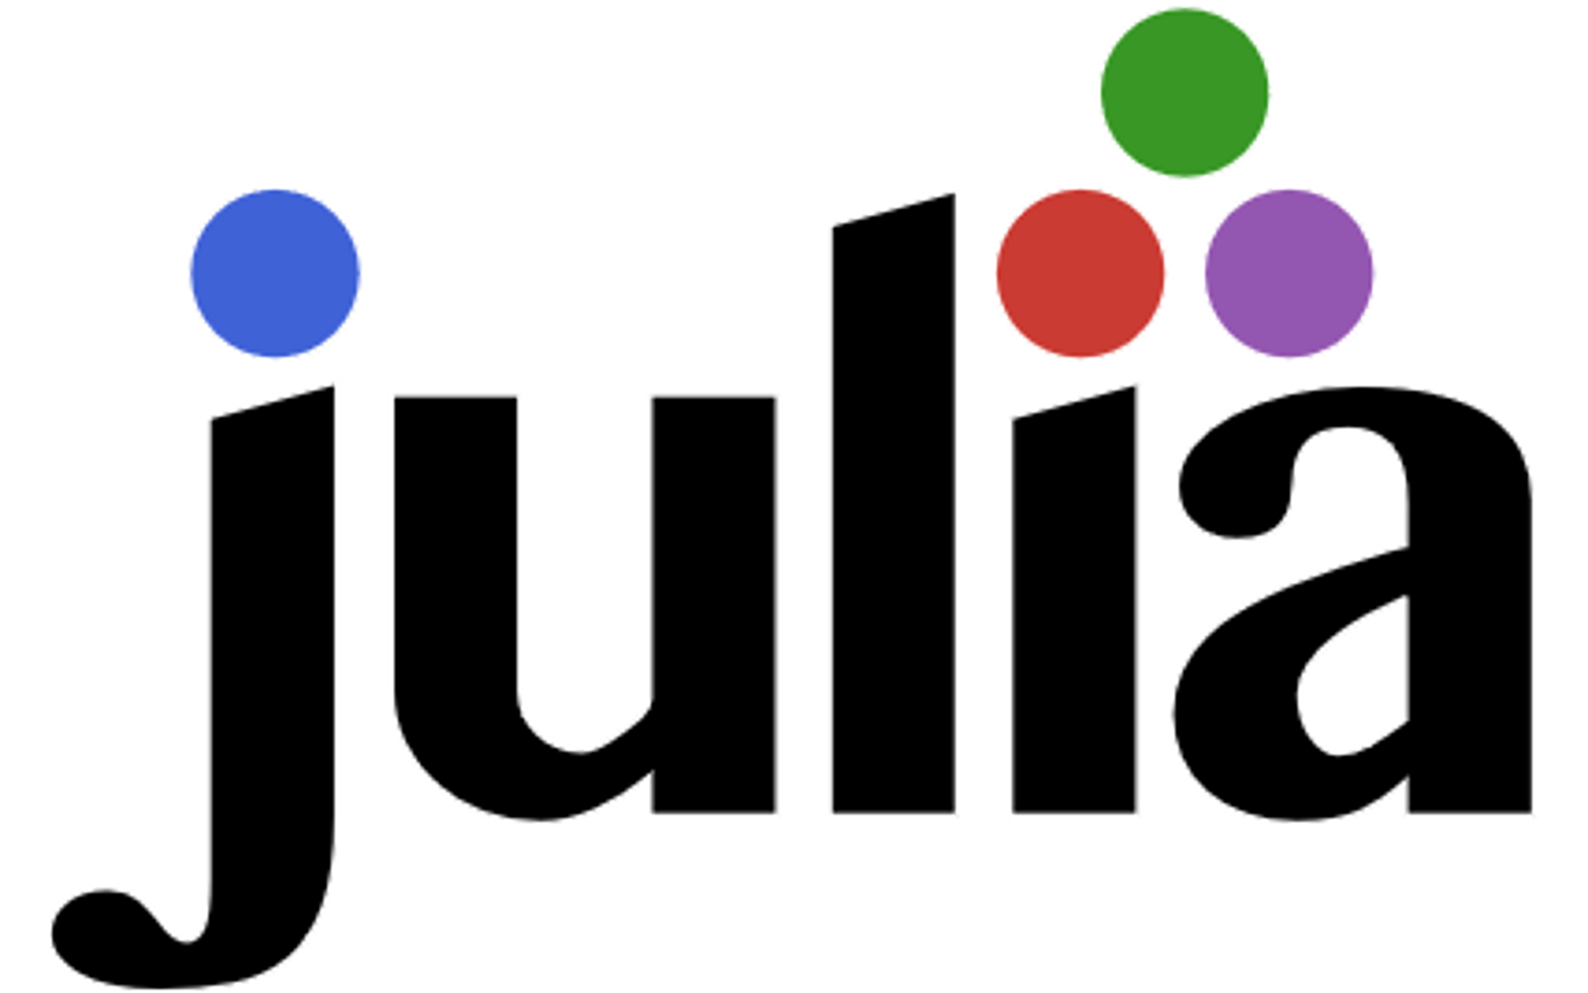
The programming language for scientists
Carsten Bauer @ University of Cologne, October 2019

Slide 3



What does science need from a programming language?
Easy to write and read
Fast and scalable
Interactive

Slide 4

What does science need from a programming language?
Easy to write and read

Slide 5
What does science need from a programming language?
Fast and scalable

Slide 6
What does science need from a programming language?
Interactive

Slide 7


What does science need from a programming language?
Easy to write, read, and understand
Fast and scalable
Interactive

Slide 8







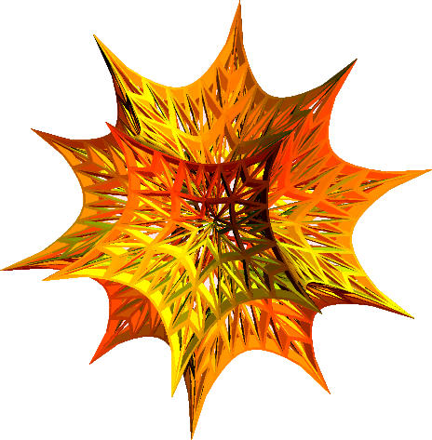
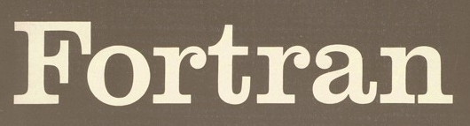
There’s a plethora of programming languages

Slide 9
There’s a plethora of programming languages

Slide 10
There’s a plethora of programming languages
Slow(ish)
Fast

Slide 11
There’s a plethora of programming languages
Compiled
Interpreted

Slide 12
There’s a plethora of programming languages
Static
Dynamic

Slide 13
There’s a plethora of programming languages
Speed
Convenience

Slide 14
The “two language problem”
a.k.a Ousterhout's dichotomy
Prototype
Production

Slide 15
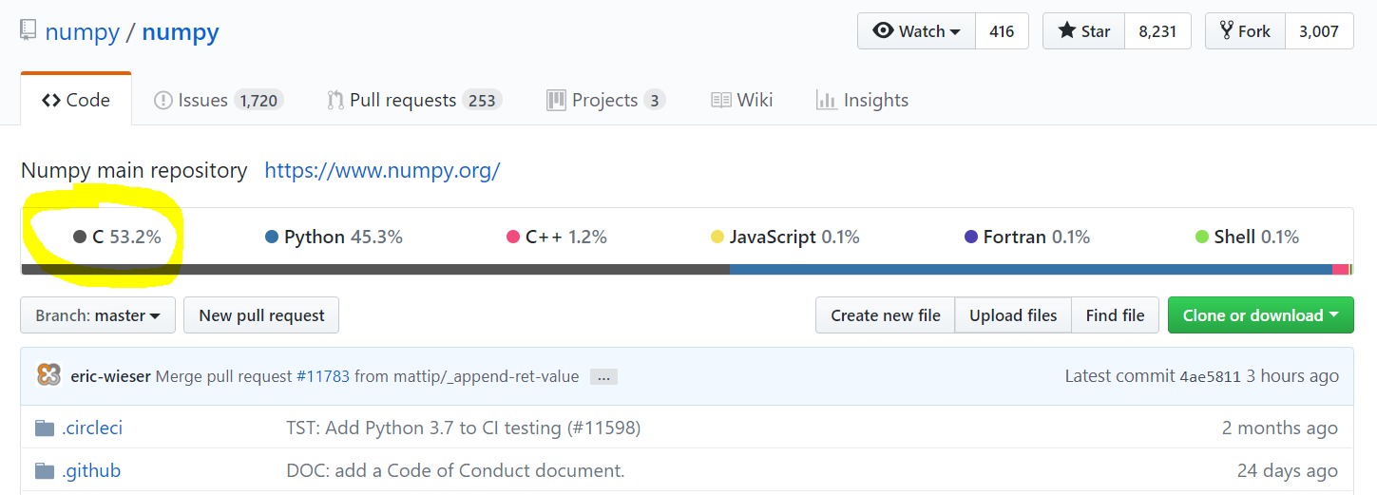
The “two language problem”

Slide 16

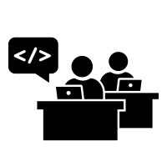

The “two language problem”
User
Developer

Slide 17
The “two language problem”
static
dynamic
compiled
interpreted
user types
standard types
standalone
glue

Slide 18
dynamic
compiled
user types
and
standard types
standalone
or
glue
“Feels like Python, runs like C”

Slide 19
What do we want from a PL?
The unification
Simple yntax + grammar
Simple syntax + grammar
Fast answers
Interactivity

Slide 20
What do we want from a PL?
The unification
function babylonian(α; N = 10)
@assert α > 0 "α must be > 0"
t = (1+α)/2
for i = 2:N
t = (t + α/t)/2
end
t
end
babylonian(π) ≈ √π
Simple syntax + grammar
Fast answers
Interactivity
“Feels like Python, runs like C”

Slide 21
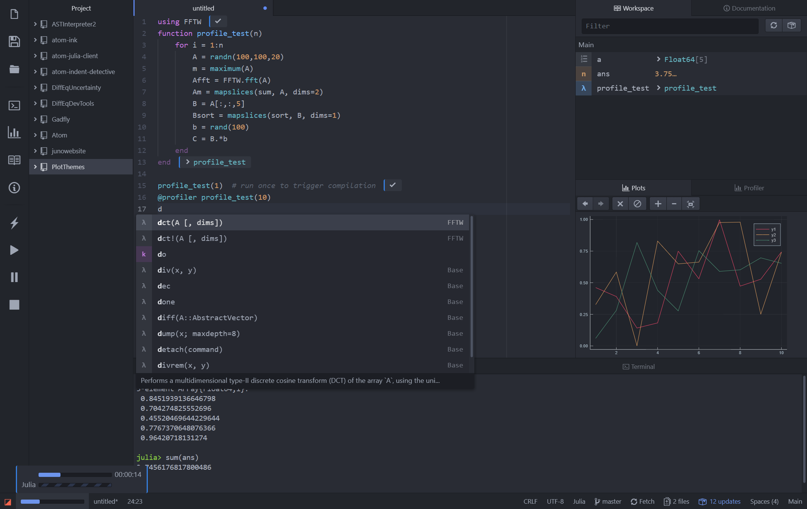
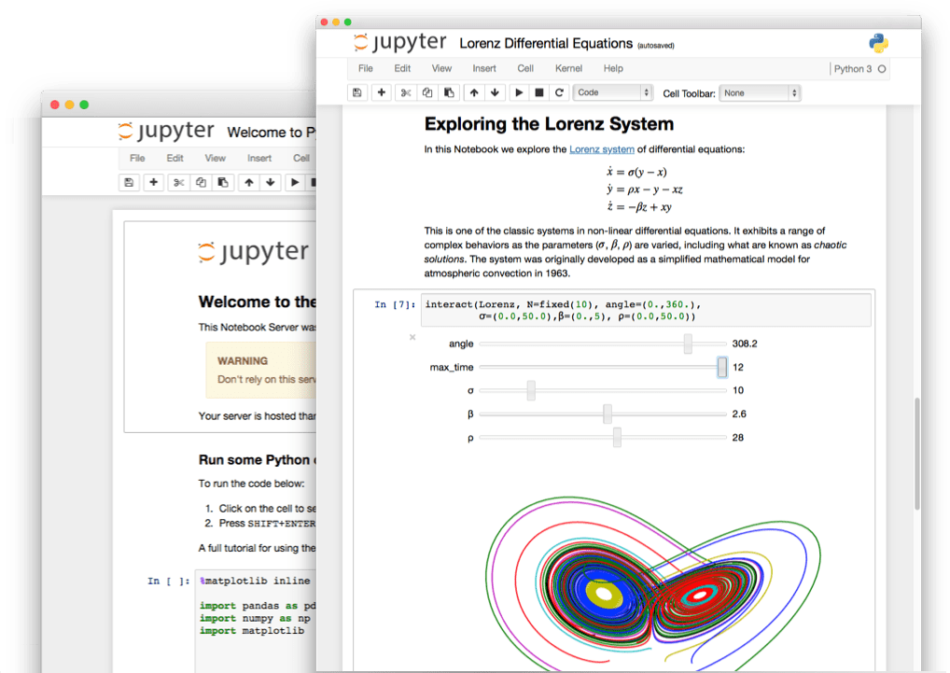
What do we want from a PL?
The unification
Simple yntax + grammar
Simple syntax + grammar
Fast answers
Interactivity
“Feels like Python, runs like C”

Slide 22
What do we want from a PL?
The unification
julia> function sumup()
x = 0
for i in 1:100
x += i
end
x
end
sumup (generic function with 2 methods)
julia> @code_llvm debuginfo=:none sumup()
; Function Attrs: uwtable
define i64 @julia_sumup_12626() #0 {
top:
ret i64 5050
}
Simple yntax + grammar
Simple syntax + grammar
Fast answers
Interactivity
Just returns the answer!
(The for loop was compiled away)
“Feels like Python, runs like C”

Slide 23
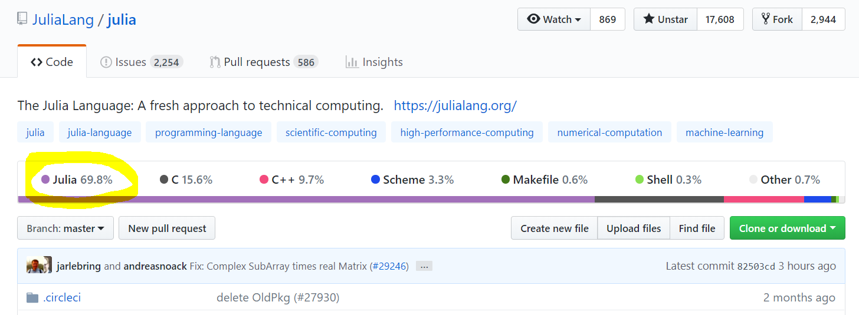
It is free and open source

Slide 24

It is inviting
User
Developer

Slide 25
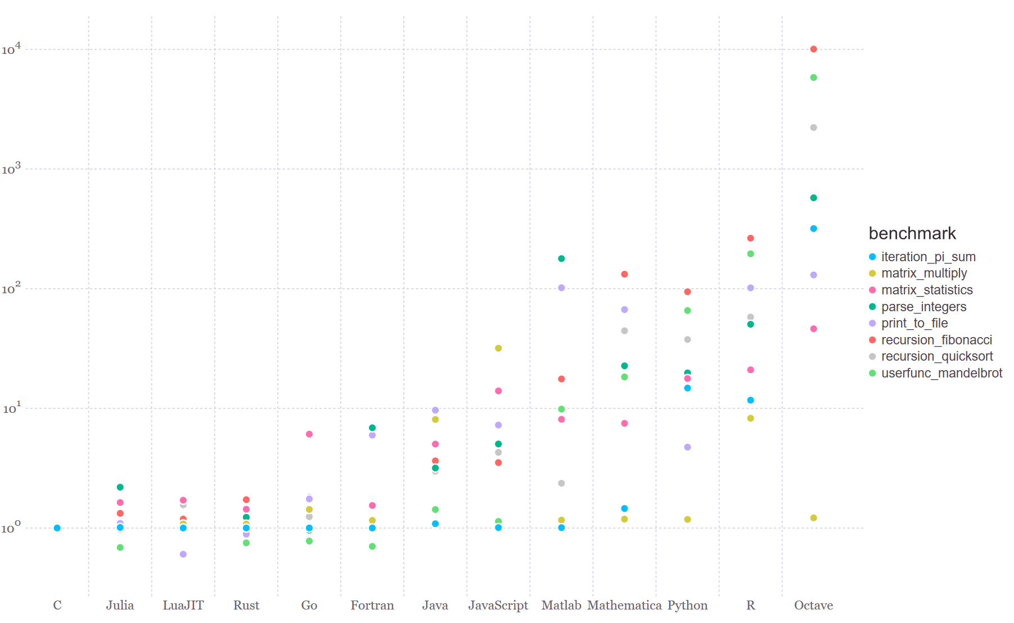
It is fast

Slide 26
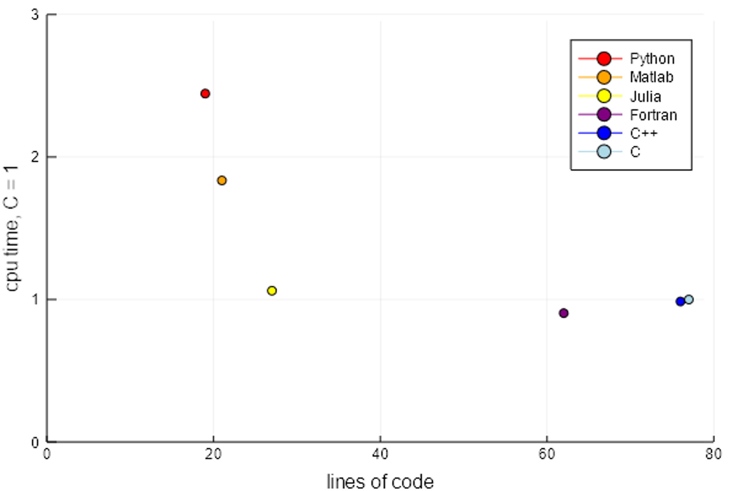
It is expressive

Slide 27
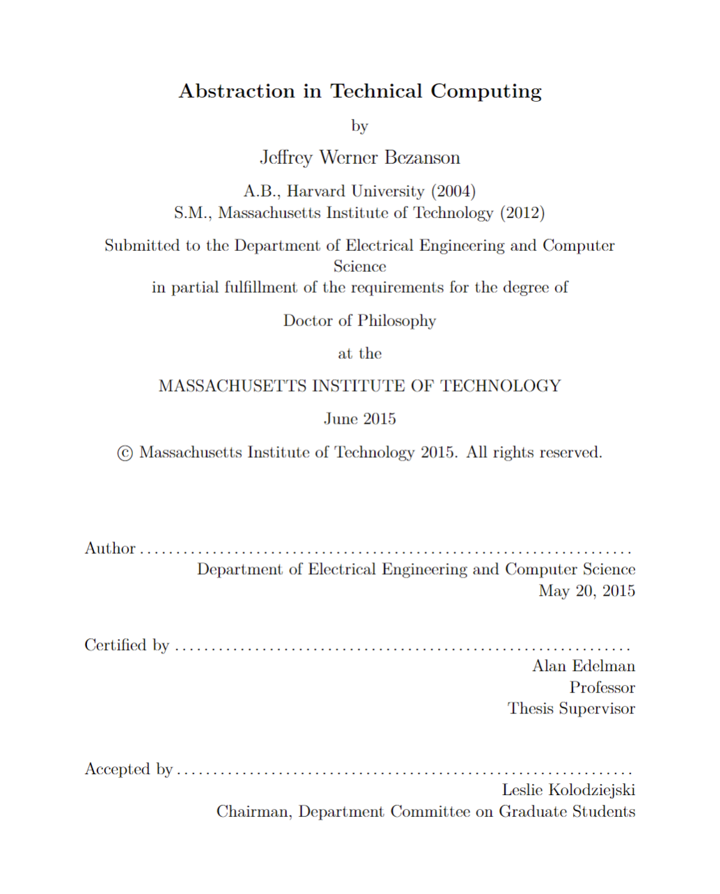
How old is Julia?
2009 Jeff, Stefan, Viral, and Alan start working on Julia
2012 Blog post: Why we created Julia
2015 Jeff’s PhD & JuliaComputing
2018 Julia 1.0
Founders talk @ JuliaCon 2018: https://www.youtube.com/watch?v=1jN5wKvN-Uk

Slide 28

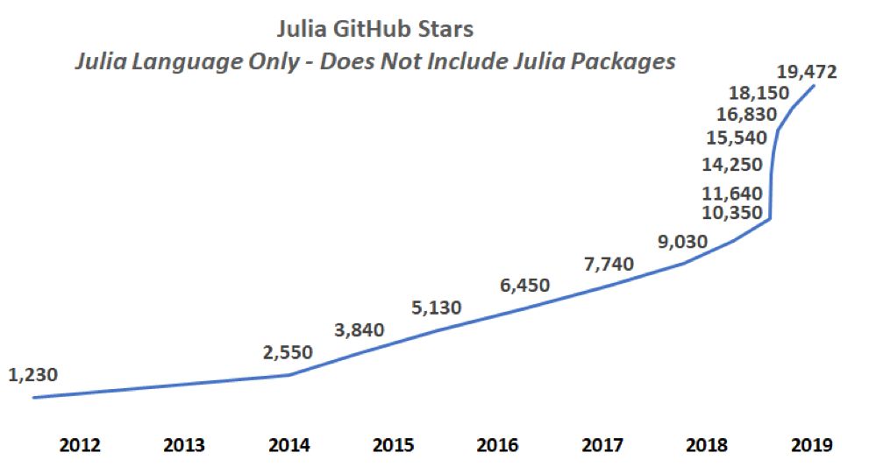
Julia stars
* Base language, does not include packages
https://juliacomputing.com/blog/2019/01/04/january-newsletter.html

Slide 29
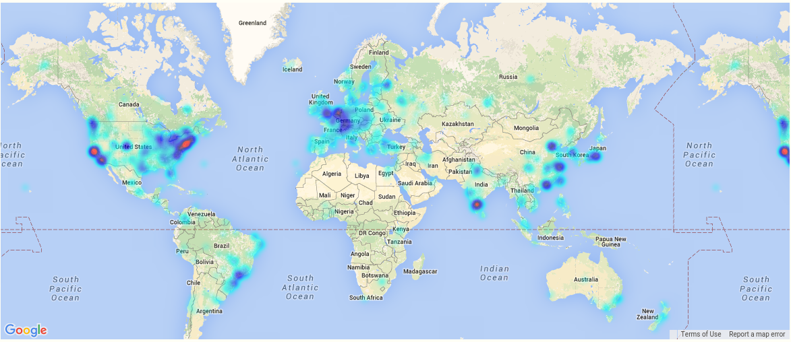
A global community
More than 3 Million downloads, 2500 packages

Slide 30
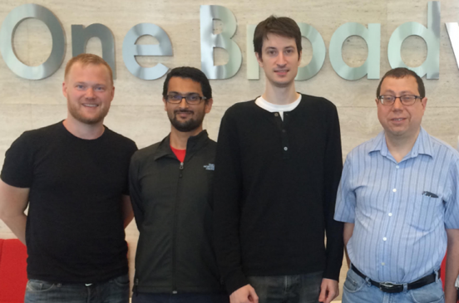

Stefan Karpinski
Viral B. Shah
Jeff Bezanson
(2019)
Keno Fischer
(2019)
Prof. Alan Edelman
(2018)
James H. Wilkinson Prize
For Numerical Software
Forbes
30 under 30
IEEE Babbage Prize
IEEE Fellow

Slide 31
James H. Wilkinson Prize
For Numerical Software
Forbes
30 under 30
IEEE Babbage Prize
IEEE Fellow
Stefan Karpinski
Viral B. Shah
Jeff Bezanson
(2019)
Keno Fischer
(2019)
Prof. Alan Edelman
(2018)

Slide 32































Notes:
Universities teaching Julia

Slide 33
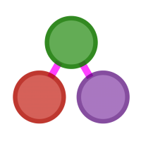
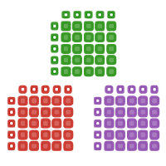


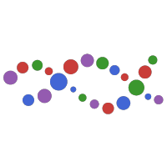


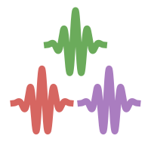
Best in class packages
Differential Equations
Graph Processing
Data Science
Image Processing
Deep Learning
Mathematical Optimization
Signal Processing
Computational Biology

Slide 34


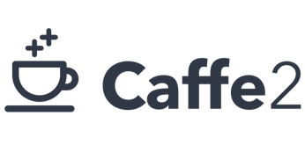


Knet.jl

Slide 35
Recommended talks
Nick Eubank: What Julia Offers Academic Researchers
George Datseris: Why Julia is the most suitable language for science

